Slide 1
Chapter 3
GUI

Slide 2
Defining the User Interface
A collection of techniques and mechanisms to interact with something.
The user interface is a part of computer and its software that people can see, hear, touch, and talk to.
The primary mechanism is a pointing device of some kind.
Objects
Collection of elements to which user interacts.
Can be seen, heard or touched.
Actions
Operations performed on objects.
Pointing, selecting, manipulating etc…

Slide 3
Importance of good design
A well designed interface is a window to view the system capabilities of the system.
If they are confusing and inefficient, people will have greater difficulty in doing their jobs and will make more mistakes.
Poor design chase some people away from a system permanently.

Slide 4
Benefits of good screen design
Productivity benefits.
Improve screen clarity and readability.
Reduce decision making time.
Fewer errors.
Lower training cost
Easy to identify and resolve problems during design and development process.

Slide 5
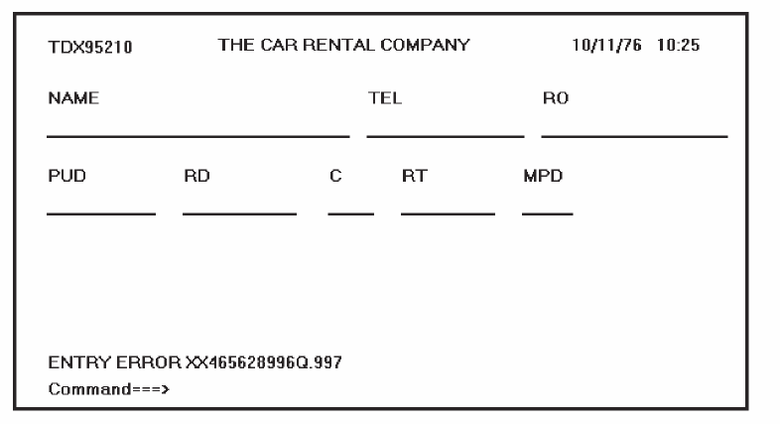
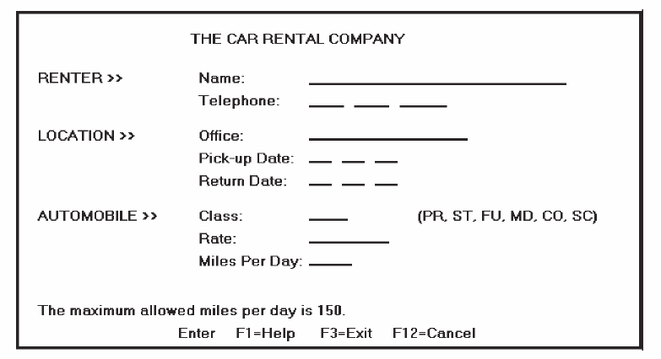
Importance of good design
A 1970 screen
A 1980 screen

Slide 6
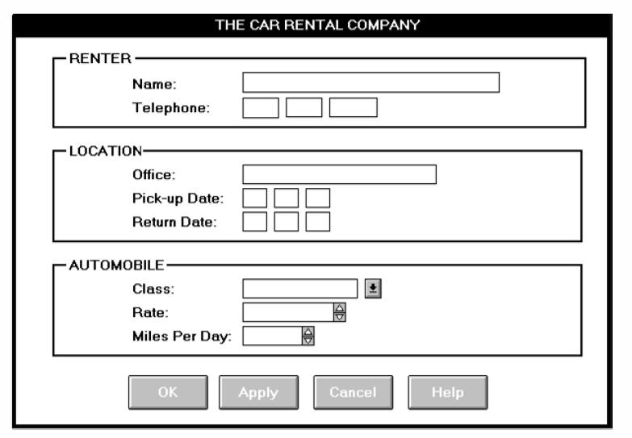
Importance of good design
A 1990 screen

Slide 7
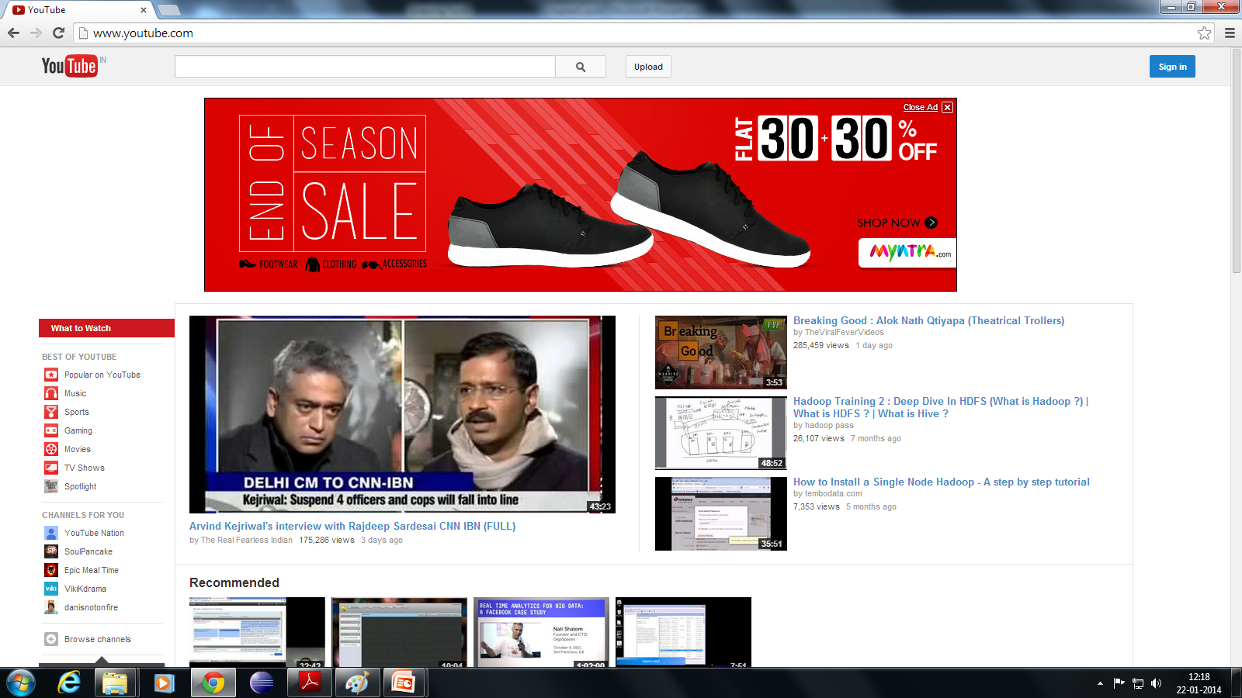
2000 Onwards Screen

Slide 8
Popularity of Graphics

Slide 9
DIRECT MANIPULATION
DM systems have the following characteristics.
The system is portrayed as an extension of the real world.
Continuous visibility of objects and actions.
Actions are rapid and incremental with visible display of results.
Incremental actions are easily reversible.

Slide 10
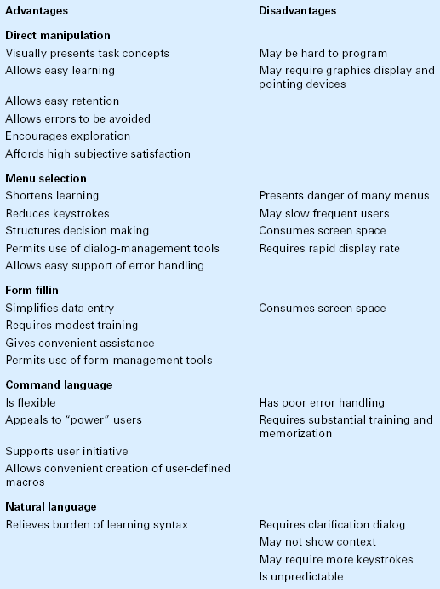
Interaction Styles
Styles for “giving commands” to the system
5 main types
Direct Manipulation
Menu selection
Form fillin
Command language
Natural language

Slide 11
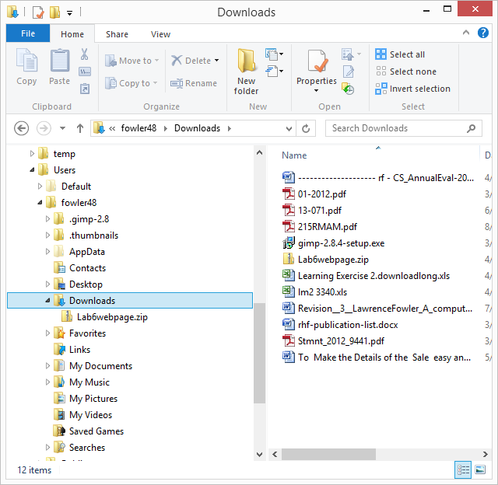
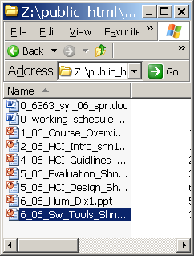
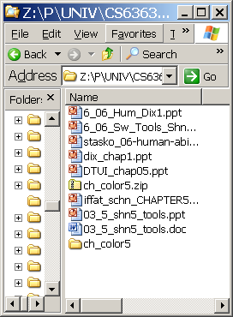
Interaction Styles

Slide 12

EXAMPLE DIRECT MANIPULATION
Drive a car
If you want to turn left, what do you do?
What type of feedback do you get?
How does this help?
Think about turning left using a menu/text interfaces

Slide 13
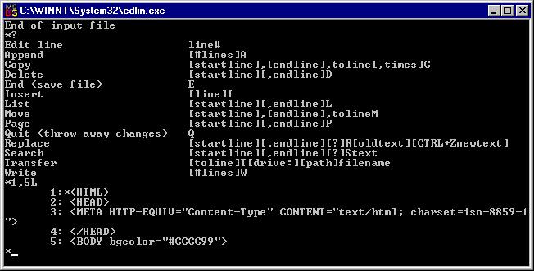
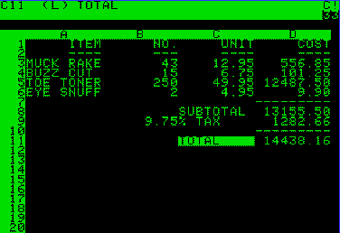
EXAMPLE DIRECT MANIPULATION

Slide 14
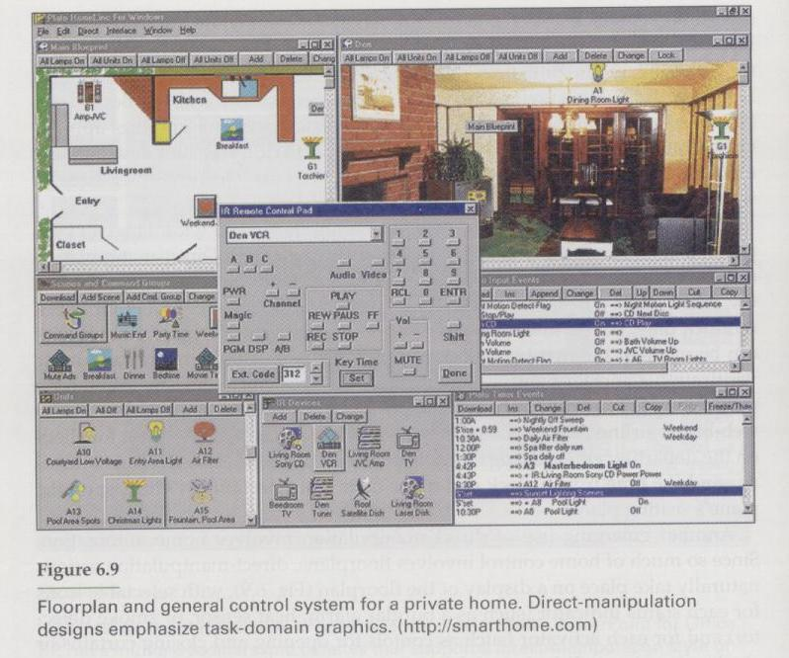
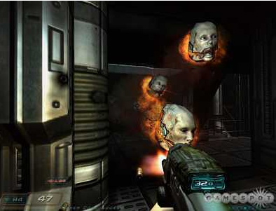
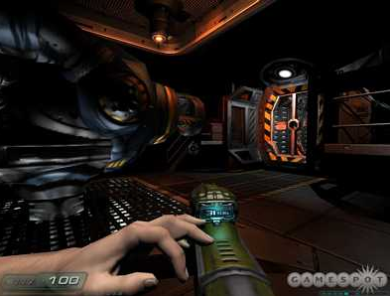
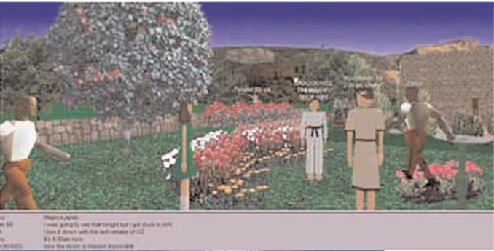
EXAMPLE DIRECT MANIPULATION

Slide 15
LIMITATIONS OF DIRECT MANIPULATION
Direct Manipulation of all screen objects may not be feasible.
Graphics capability of system may be limited.
The amount of space available for placing manipulation controls in the window border may be limited.
Screen space
Takes up plenty
Multiple pages can slow user down
Bad design is amplified
Learning curve – users have to remember all the necessary operations and actions.

Slide 16
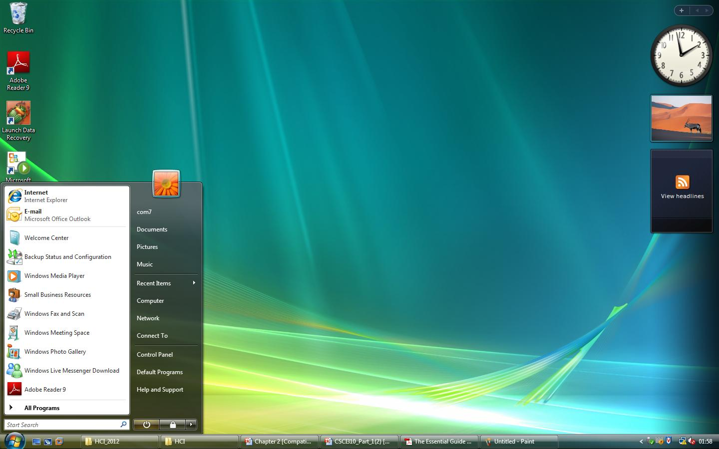
INDIRECT MANIPULATION
It uses
words and text,
pull-down and pop-up menus,
symbols,
And typing and pointing.
Most windows systems are combination of direct and indirect manipulation.

Slide 17
THE GRAPHICAL USER INTERFACE
A User interface is a collection of techniques and mechanisms to interact with something.
User interact with a collection of elements referred to as Objects.
In graphical interface, the primary interaction mechanism is a pointing device of some kind.
Graphics revolutionized design and the user interface.
Improvement in display enable the user’s actions to be reacted quickly, dynamically and meaningfully.

Slide 18
GRAPHICAL SYSTEM ADVANTAGES
Symbols recognized faster than text
Faster learning
Faster use and problem solving
Easier remembering
Provides context
Fewer errors
Immediate feedback

Slide 19
GRAPHICAL SYSTEM ADVANTAGES
Predictable system responses
Easily reversible actions
More attractive
May consume less space
Replaces national languages
Low typing requirements
Smooth transition from command language system.

Slide 20
GRAPHICAL SYSTEM DISADVANTAGES
Greater Design Complexity.
Learning still necessary.
Inconsistencies in technique and terminology.
Not always familiar.
Human comprehension limitations.
Windows manipulation requirements.
Production limitation (few tested icons exist).
Not always fastest style of interaction.

Slide 21
GRAPHICAL SYSTEM DISADVANTAGES
Inefficient for expert users.
Not always the preferred style of interaction.
Increased chance of clutter and confusion.
May consume more screen space.
Hardware limitation.

Slide 22
Conclusion
The design of an interface, and not its interaction style, is the best determinant of ease of use. (ex. Rural ATM)
User preferences must be considered in choosing an interaction style. (ex. s/w for disable)
In majority of cases, words are more meaningful to users than icons. (ex. Photoshop/corel draw screen)

Slide 23
Conclusion
The content of a graphic screen is critical to its usefulness. The wrong presentation or a cluttered presentation may actually lead to greater confusion.
The success of a graphical system depends on the skills of its designers in following established principles of usability.

Slide 24
CHARACTERISTICS OF THE GRAPHICAL INTERFACE
Sophisticated Visual Presentation
Use of lines, drawings, icons, variety of character fonts, colors etc.
Pick-and-Click Interaction
Pick : to identify the element for the proposed action.
Click : signal to perform the action.
Restricted Set of Interface Option
Concurrent Performance of Functions
Object Orientation

Slide 25
CHARACTERISTICS OF THE GRAPHICAL INTERFACE
Object Orientation
Objects and sub objects
Types of Object
Data Object (Screen controls)‏
Container Object (Workplace/ Work Area, Folders)‏
Device Object (Printer, Trash)‏
Relationships
Collection: Objects sharing common aspects (multiple selection objects)
Constraint : Stronger object relationship (document)
Composite : Aggregation of them identified as an object (spread sheets)

Slide 26
CHARACTERISTICS OF THE GRAPHICAL INTERFACE
Object Orientation
Properties of object
Text styles
Font size
Windows background color
Actions
Commands: To manipulate objects in specific way.
Property/attribute Specification : To modify object properties.
Views
Composed views: presents information and the objects contained within an object.
Contents views: list the components of objects.
Settings Views: permit seeing and changing object properties.
Help Views: provide all help functions.

Slide 27
Questions
What is Direct Manipulation? Example.
What is Indirect Manipulation? Example.
Any two Advantages of GUI.
Any two Disadvantages of GUI.
List Characteristics of GUI.
Types of objects.
Relationships of objects.

Slide 28
THE WEB USER INTERFACE
Web interface design is the design of navigation and the presentation of information.
It is about content, not data.
The design goal is to build a hierarchy of menus and pages that feels natural, well structured, easy to use, and truthful.
Popular
Allows millions of people scattered across the globe to communicate and publish/access information.
Difficulties
Its design language is HTML.
Architecture and task flow are not easy to standardize.

Slide 29
Characteristics of a Web Interface
A web interface has a number of characteristics , some similar to a GUI (?) and some different.
They are
Devices
User Focus
Data/ Information
User Tasks
User’s Conceptual Space
Presentation Elements
Navigation
Context
Interaction
Response Time
Visual Style
System capability
Task Efficiency
Consistency
User Assistance
Integration
Security
Reliability

Slide 30
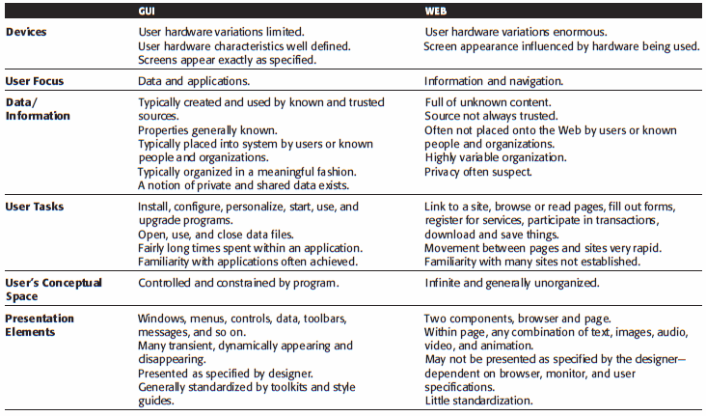
GUI versus WEB PAGE DESIGN

Slide 31
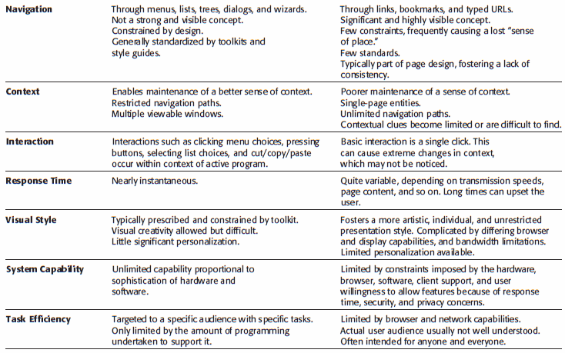
GUI versus WEB PAGE DESIGN

Slide 32
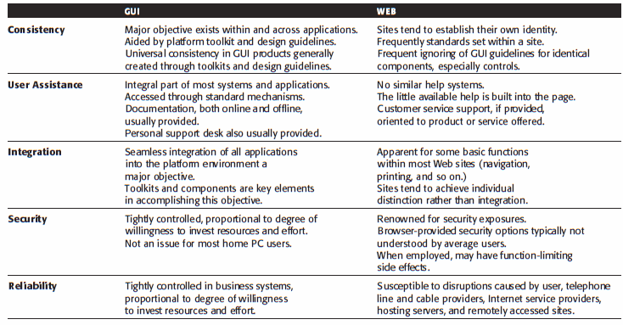
GUI versus WEB PAGE DESIGN

Slide 33
GENERAL DESIGN PRINCIPLES
Aesthetically Pleasing
Provide visual appeal by:
Providing meaningful contrast between screen elements
Creating groupings
Aligning screen elements and groups
Providing three-dimensional representation
Using color and graphics effectively and simply

Slide 34
GENERAL DESIGN PRINCIPLES
Clarity
The interface should be visually, conceptually, and linguistically clear, including:
Visual elements
Functions
Metaphors
Words and text
Compatibility
Provide compatibility with the following:
The user
The task and job
The product
Adopt the user’s perspective.

Slide 35
GENERAL DESIGN PRINCIPLES
Comprehensibility
A system should be easily learned and understood:
What to look at
What it is
What to do
When to do it
Where to do it
Why to do it
How to do it
Flow of actions, response, visual presentations, and information should be:
In a sensible order
Easy to recollect
Easy to place in context

Slide 36
GENERAL DESIGN PRINCIPLES
Configurability
Permit easy personalization, configuration, and reconfiguration of settings.
Enhances a sense of control
Encourages an active role in understanding
Consistency
A system should look, act, and operate the same throughout. Similar components should:
Have a similar look
Have similar uses
Operate similarly
The same action should always yield the same result.
The function of elements should not change.
The position of standard elements should not change.

Slide 37
GENERAL DESIGN PRINCIPLES
Control
The user must control the interaction.
The context maintained must be from the perspective of the user.
The means to achieve goals should be flexible and compatible with the user's skills, experiences, habits and preferences.
Avoid modes because they constrain the actions available.
Permit the user to customize the interface but provide defaults.

Slide 38
GENERAL DESIGN PRINCIPLES
Directness
Provide direct ways to accomplish tasks.
Available alternatives should be visible.
The effect of actions on objects should be visible.
Efficiency
Minimize eye and hand movements, and other control actions.
Transitions between various system controls should flow easily and freely.
Navigation paths should be as short as possible.
Eye movement through a screen should be obvious and sequential.
Anticipate the user’s wants and needs whenever possible.

Slide 39
GENERAL DESIGN PRINCIPLES
Familiarity
Employ familiar concepts and use a language that is familiar to the user
Keep the interface natural, mimicking the user’s behaviour patterns
Use real-world metaphors
Flexibility
A system must be sensitive to the differing needs of its users, enabling a level and type of performance based upon:
Each user’s knowledge and skills
Each user’s experience
Each user’s personal preference
Each user’s habits
The conditions at that moment

Slide 40
GENERAL DESIGN PRINCIPLES
Forgiveness
Tolerate and forgive common and unavoidable human errors
Prevent errors from occurring whenever possible
Protect against possible catastrophic errors
When an error does occur, provide constructive messages

Slide 41
GENERAL DESIGN PRINCIPLES
Predictability
The user should be able to anticipate the natural progression of each task.
Provide distinct and recognizable screen elements
Provide cues to the result of an action to be performed
All expectations should be fulfilled uniformly and completely.
Recovery
A system should permit:
Commands or actions to be abolished or reversed
Immediate return to a certain point if difficulties arise
Ensure that users never lose their work as a result of:
An error on their part
Hardware, software, or communication problems.

Slide 42
GENERAL DESIGN PRINCIPLES
Responsiveness
The system must rapidly respond to the user’s requests.
Provide immediate acknowledgment for all actions:
Visual
Textual
Auditory

Slide 43
GENERAL DESIGN PRINCIPLES
Simplicity
Provide as simple an interface as possible.
Five ways to provide simplicity:
Use progressive disclosure, hiding things until they are needed
Present common and necessary functions first
Prominently feature important functions
Hide more sophisticated and less frequently used functions
Provide defaults
Minimize screen alignment points
Make common actions simple
Provide uniformity and consistency

Slide 44
GENERAL DESIGN PRINCIPLES
Transparency
Permit the user to focus on the task or job, without concern for the mechanics of the interface.
Workings and reminders of workings inside the computer should be invisible to the user
Trade-Offs
Final design will be based on a series of trade-offs balancing often-conflicting design principles.
People’s requirements always take precedence over technical requirements.

Slide 45
University Questions
What is Direct and Indirect manipulation? explain with Example
Differentiate between Graphical user interface and Web page design
Explain general principles in User interface Design.

